Slide 1

ERNIA INTERNA DOPO CHIRURGIA BARIATRICA: FATTORI DI RISCHIO, INCIDENZA E PREVENZIONE
Giovanni Casella
Dipartimento di Chirurgia
«Sapienza» Università di Roma -
AOU Policlinico Umberto I

Slide 2
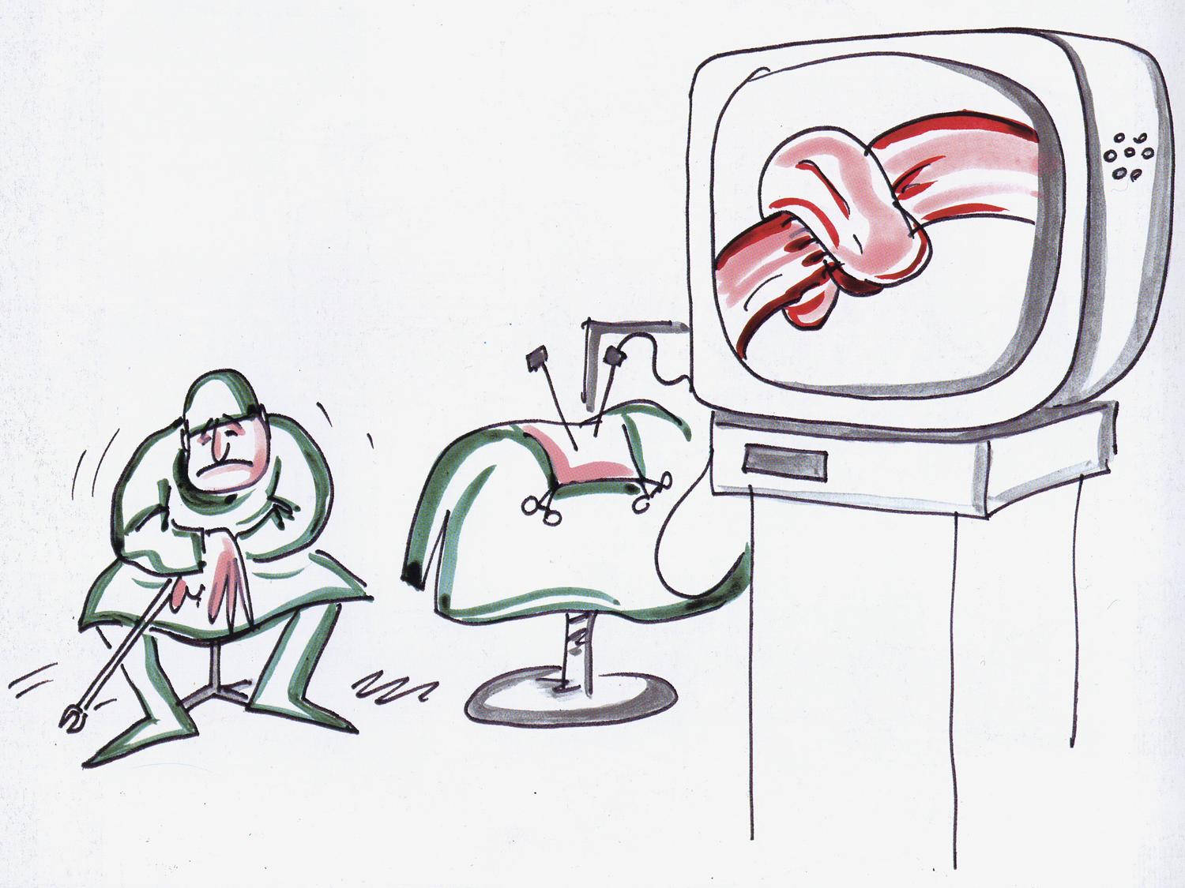
Ernia interna dopo chirurgia bariatrica: Sommario
Di che si tratta
Fattori di rischio
Prevenzione
Diagnosi
Trattamento
OAGB

Slide 3

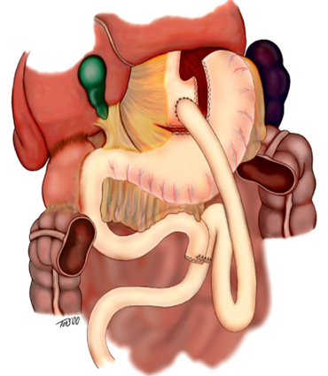
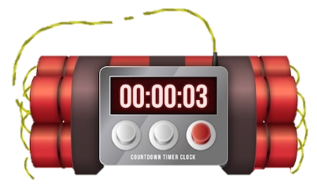
Ernia interna dopo chirurgia bariatrica:
DI CHE SI TRATTA
RISK OF INTERNAL HERNIA NEVER ENDS

Slide 4

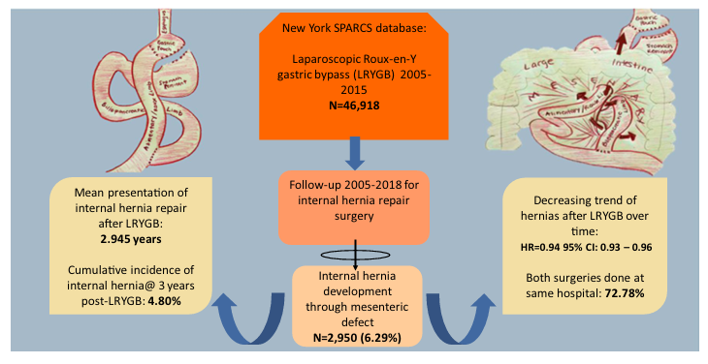
Ernia interna dopo chirurgia bariatrica:
DI CHE SI TRATTA
Multicenter study 46918 pt LRYGB between 2005 and 2015 long term F.U. (13y)
Internal Hernia 6.29%
27% Reoperation in different hospital
LRYGB earlier performed (2005) had higher IH incidence (7.28% vs 3.58%)
From 2010: mesenteric defects closure

Slide 5
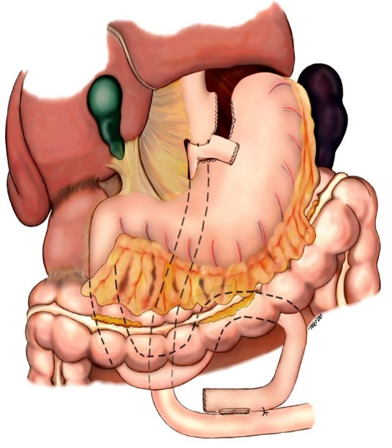
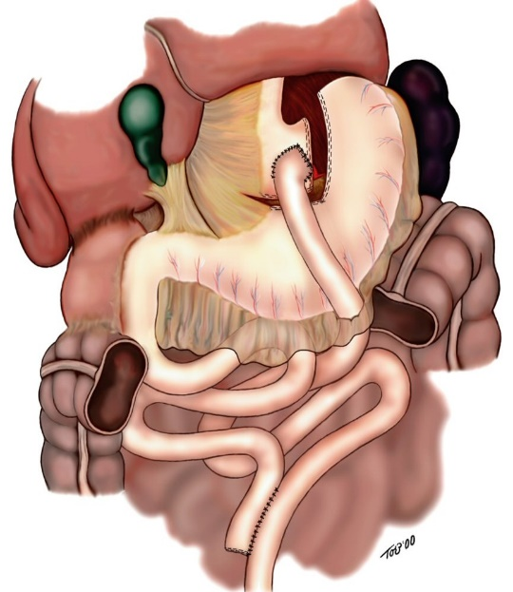

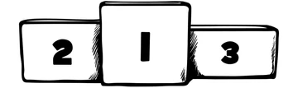



Anni 2000 –
QUALE RICOSTRUZIONE?
Transmesocolica retrogastrica
Transmesocolica antegastrica
Antecolica
antegastrica
WITTGROVE
HIGA
GAGNER

Slide 6
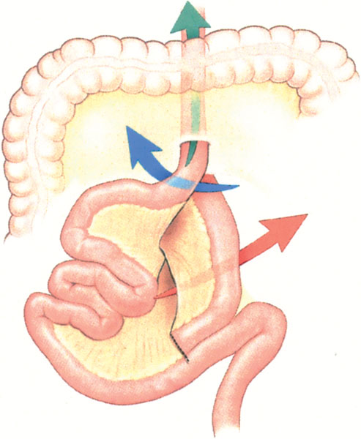
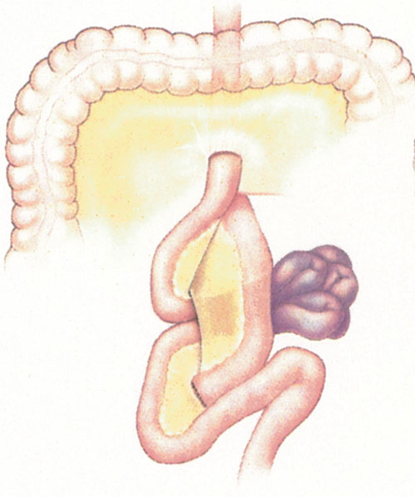
R-en-Y TRANSMESOCOLIC
67%
66 pts
7.5%
21%
HIGA et al Obesity Surgery 2003

Slide 7
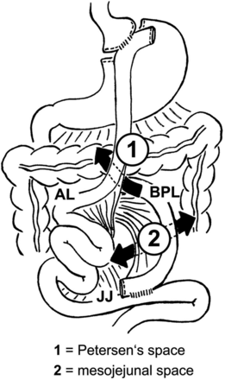

R-en-Y ANTECOLIC
Ernie Interne
2005
Comeau, M. Gagner
3,6%

Slide 8
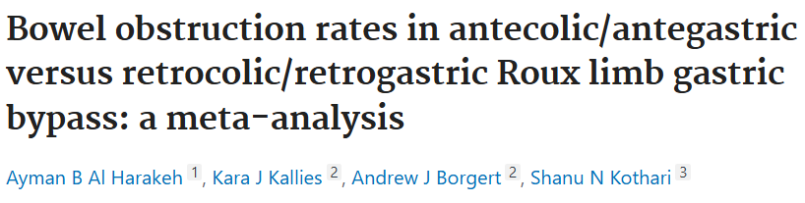
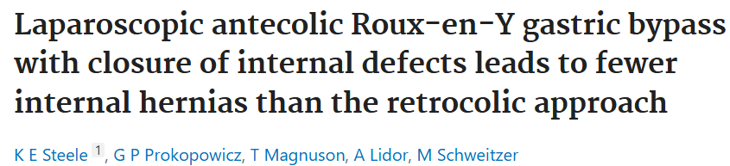
45% of pt underwent Mesenteric Defect closure in both groups
 | Bowel Obstruction | Internal Hernia
AG/AC | 1.4% | 1.3%
RG/RC | 5.2% | 2.3%
Single surgeon series
274 pt in RG/RC group
205 pt in AG/AC group
2.6% IH rate in RG/RC group
0% IH rate in AG/AC group

Slide 9
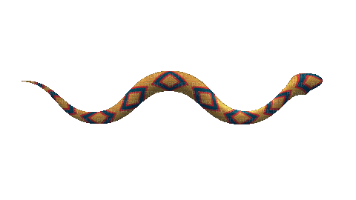


Ernia interna dopo chirurgia bariatrica:
CLASSIFICAZIONE
2015
S-D-L
SPACE | P | B
 | Petersen | Brolin
DIRECTION | R | L
 | Right | Left
LIMB | A | B | C | EE
 | Alimentary | Biliopancreatic | Common tract | Entero-entero anastomosis

Slide 10





Ernia interna dopo chirurgia bariatrica:
FATTORI DI RISCHIO
PATIENT’S CHARACTERISTICS
Female patients
Different distribution of body fat is an hypotesis
Younger patients
Fluid/electrolyte disorders at surgery time
Accurate pre-operative study and correction of disorders
Chronic pulmonary disease
Chronic increased intra-abdominal pressure
Poor/weak connective tissue

Slide 11
Ernia interna dopo chirurgia bariatrica:
PREVENZIONE
closure
closure
closure
CLOSURE
CLOSURE
closure
CLOSURE
CLOSURE
CLOSURE
CLOSURE
closure
CLOSURE
closure

Slide 12
Ernia interna dopo chirurgia bariatrica:
PREVENZIONE
Closing the mesentery is more effective in reducing the risk of IH
The length of hospital stay was generally shorter in the closed group than in the non-closed mesenteric group.
Reoperation was lower in the closed group than in the non-closed group.
There were no significant differences in post-op complications and weight loss between patients in the closed and non-closed mesentery groups

Slide 13
Ernia interna dopo chirurgia bariatrica:
PREVENZIONE
The overall risk of such complications seems low
Incomplete closure of the mesenteric defects causing IH
Kinking of the small bowel
Postoperative small bowel obstruction due to adhesions
Hematoma

Slide 14
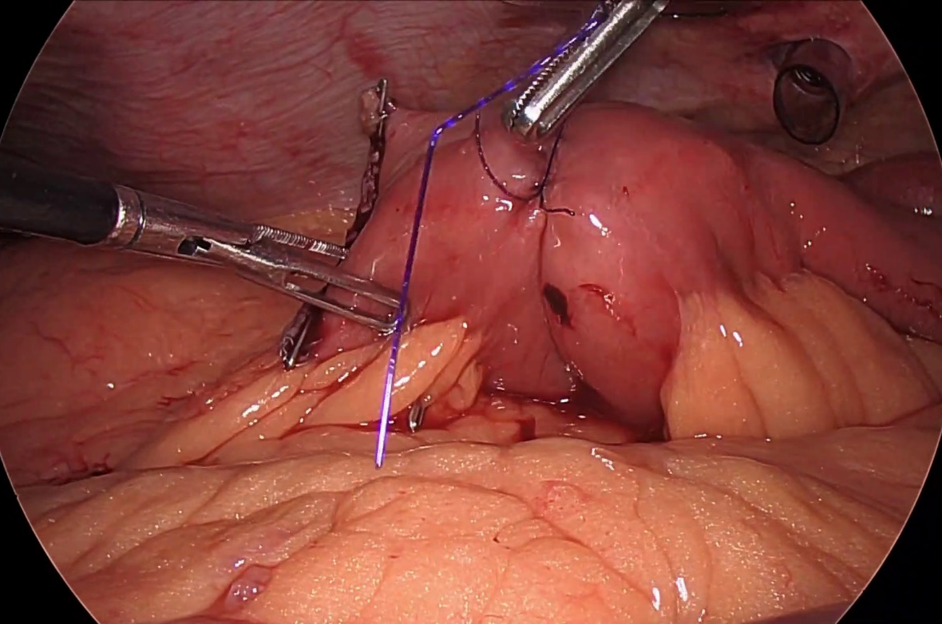
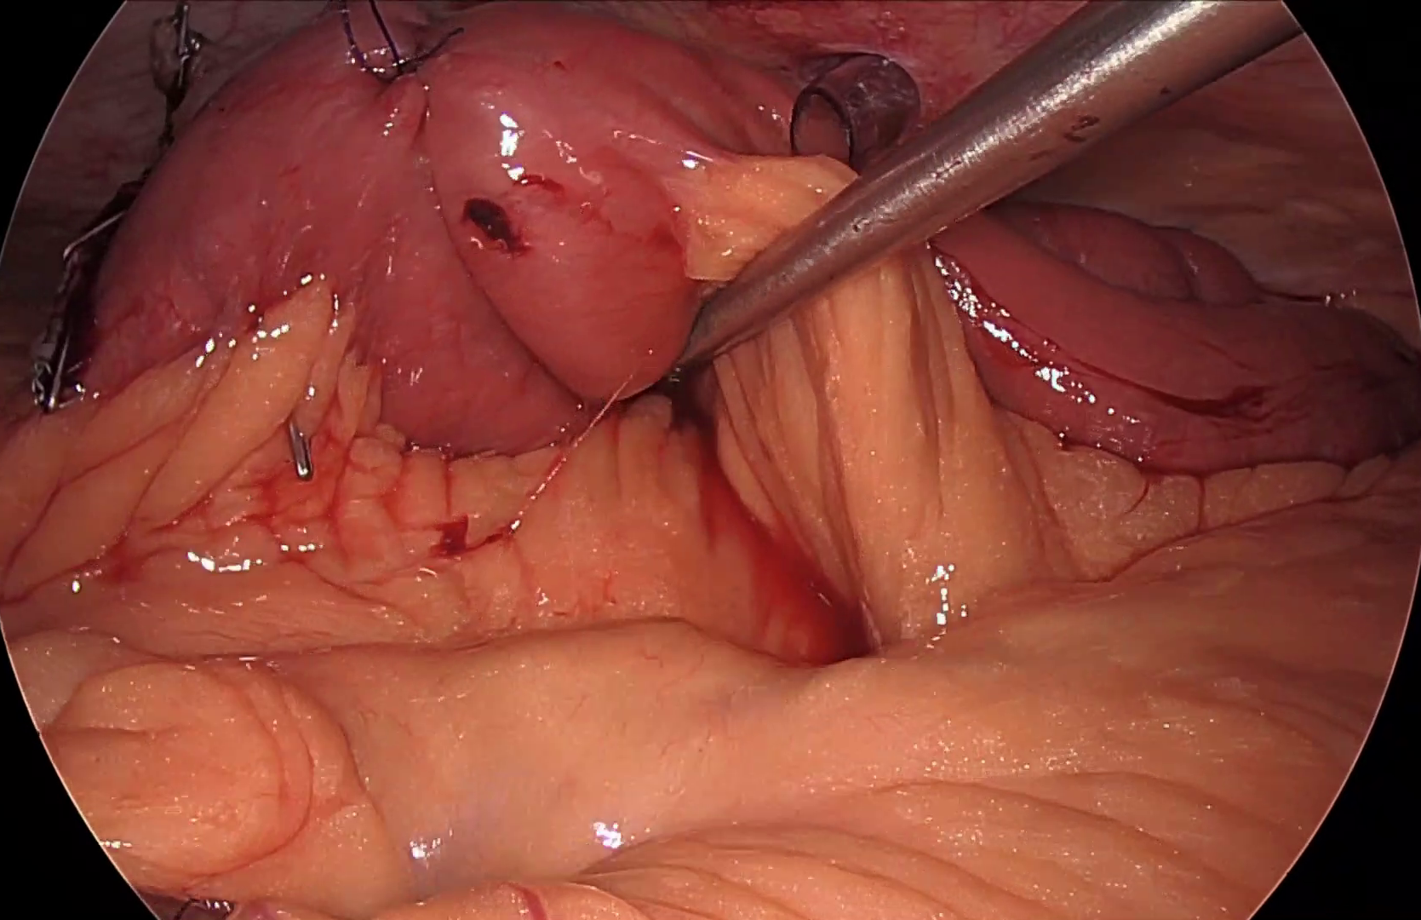
Mesenteric defect closure
Ernia interna dopo chirurgia bariatrica:
PREVENZIONE
Biliary
Alimentary

Slide 15
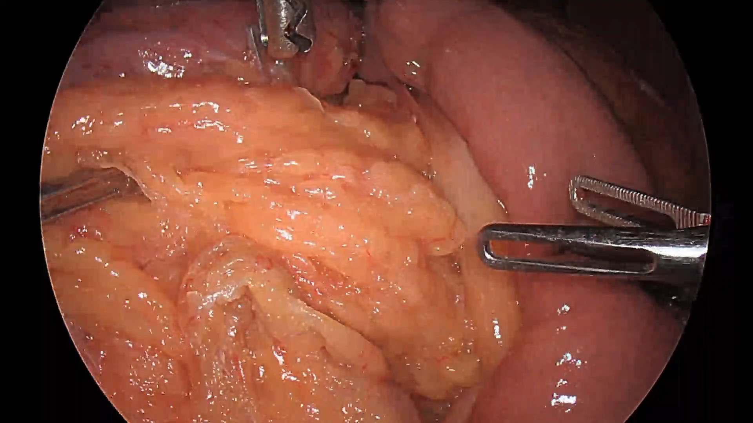
Petersen defect closure
Ernia interna dopo chirurgia bariatrica:
PREVENZIONE

Slide 16
Ernia interna dopo chirurgia bariatrica:
DIAGNOSI
CT scan
Low sensibility
High specificity
Acute/Chronic abdominal pain rate after GBP is 33.8-54.4%
Suspect IH
Occlusion
GOLD STANDARD:
DIAGNOSTIC LAPAROSCOPY
Back Pain
Diarrhoea/constipation

Slide 17
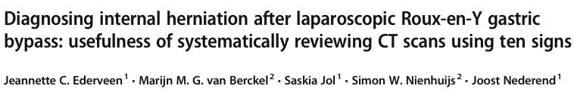
EHV20:10 signs at CT scan to improve sensitivity and specificity
SIGN | DESCRIPTION
SWIRL SIGN | Swirled appearance of mesenteric fat or vessels at the root of the mesentery
SMALL BOWEL OBSTRUCTION | Dilated small-bowel loops with air-fluid levels
CLUSTERED LOOPS | Clustered loops of small bowel, mostly in the left upper abdomen in case of Petersen herniation, but also possible in other abdominal quadrants in mesenteric herniation
MUSHROOM SIGN | Mushroom shape of the herniated mesenteric root with protrusion of bowel between SMA and its branches
HURRICANE EYE SIGN | Tubular/round shape of distal mesenteric fat surrounded by bowel loops
SMALL BOWEL BEHIND SMA | Small bowel other than duodenum passing posterior to the SMA
RIGHT-SIDED ANASTOMOSIS | Right-sided location of the distal jejunal anastomosis
ENLARGED NODES | Presence of enlarged mesenteric nodes as a secondary sign of lymphatic obstruction from mesenteric torsion
VENOUS CONGESTION | Tapering of mesenteric veins with subsequent engorgement
MESENTERIC OEDEMA | Haziness of the mesenteric fat

Slide 18

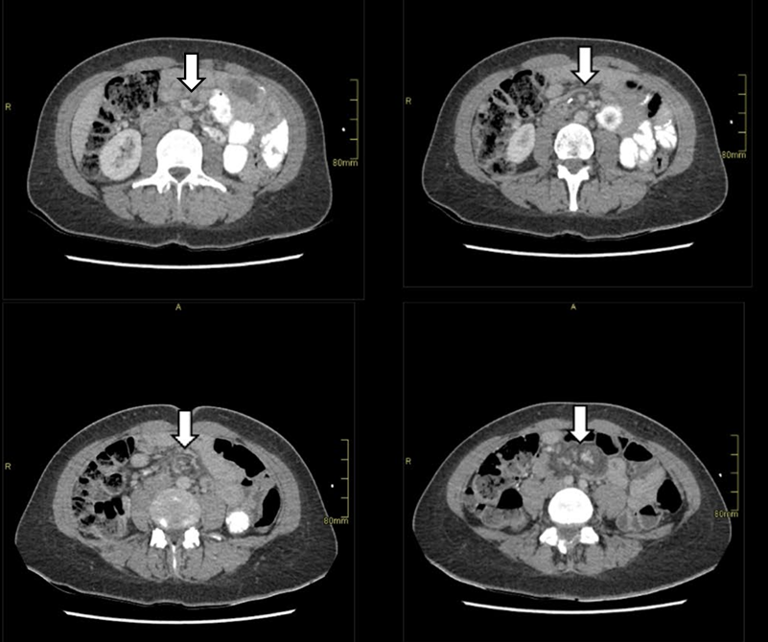

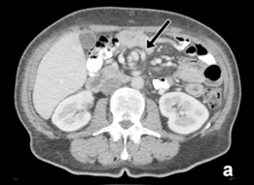
SWIRL SIGN: highest sensitivity (61-100%); 66.7% in OPERATE Study by Marjolein R.A. et al (1); 71.4-77.1% in Ederveen et al (2)

Slide 19
Ernia interna dopo chirurgia bariatrica:
TRATTAMENTO

Slide 20
Grazie

